Slide 1
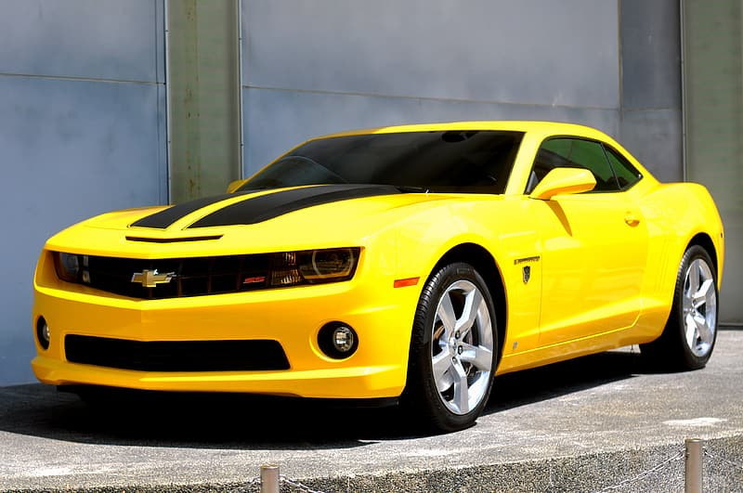
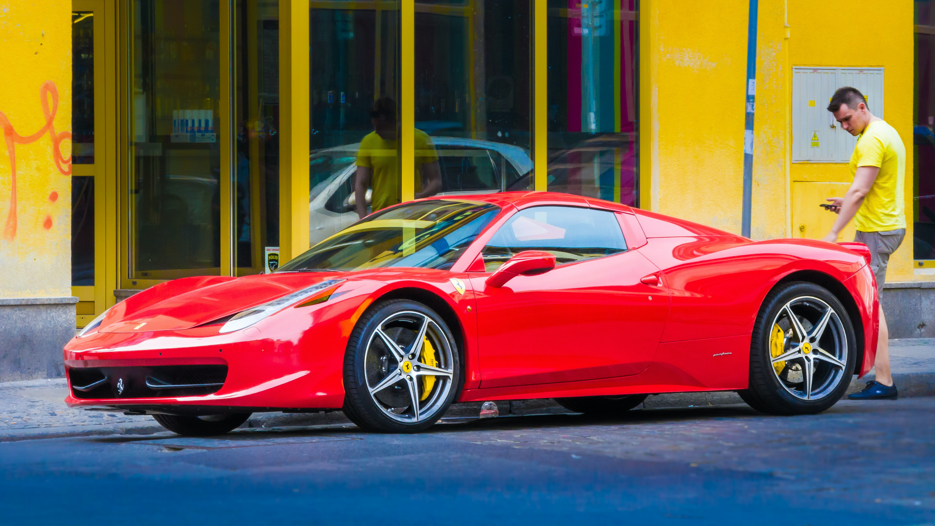
CAR PRICE PREDICTION
PRESENTED BY:
ABHIJIT SARKAR

Slide 2

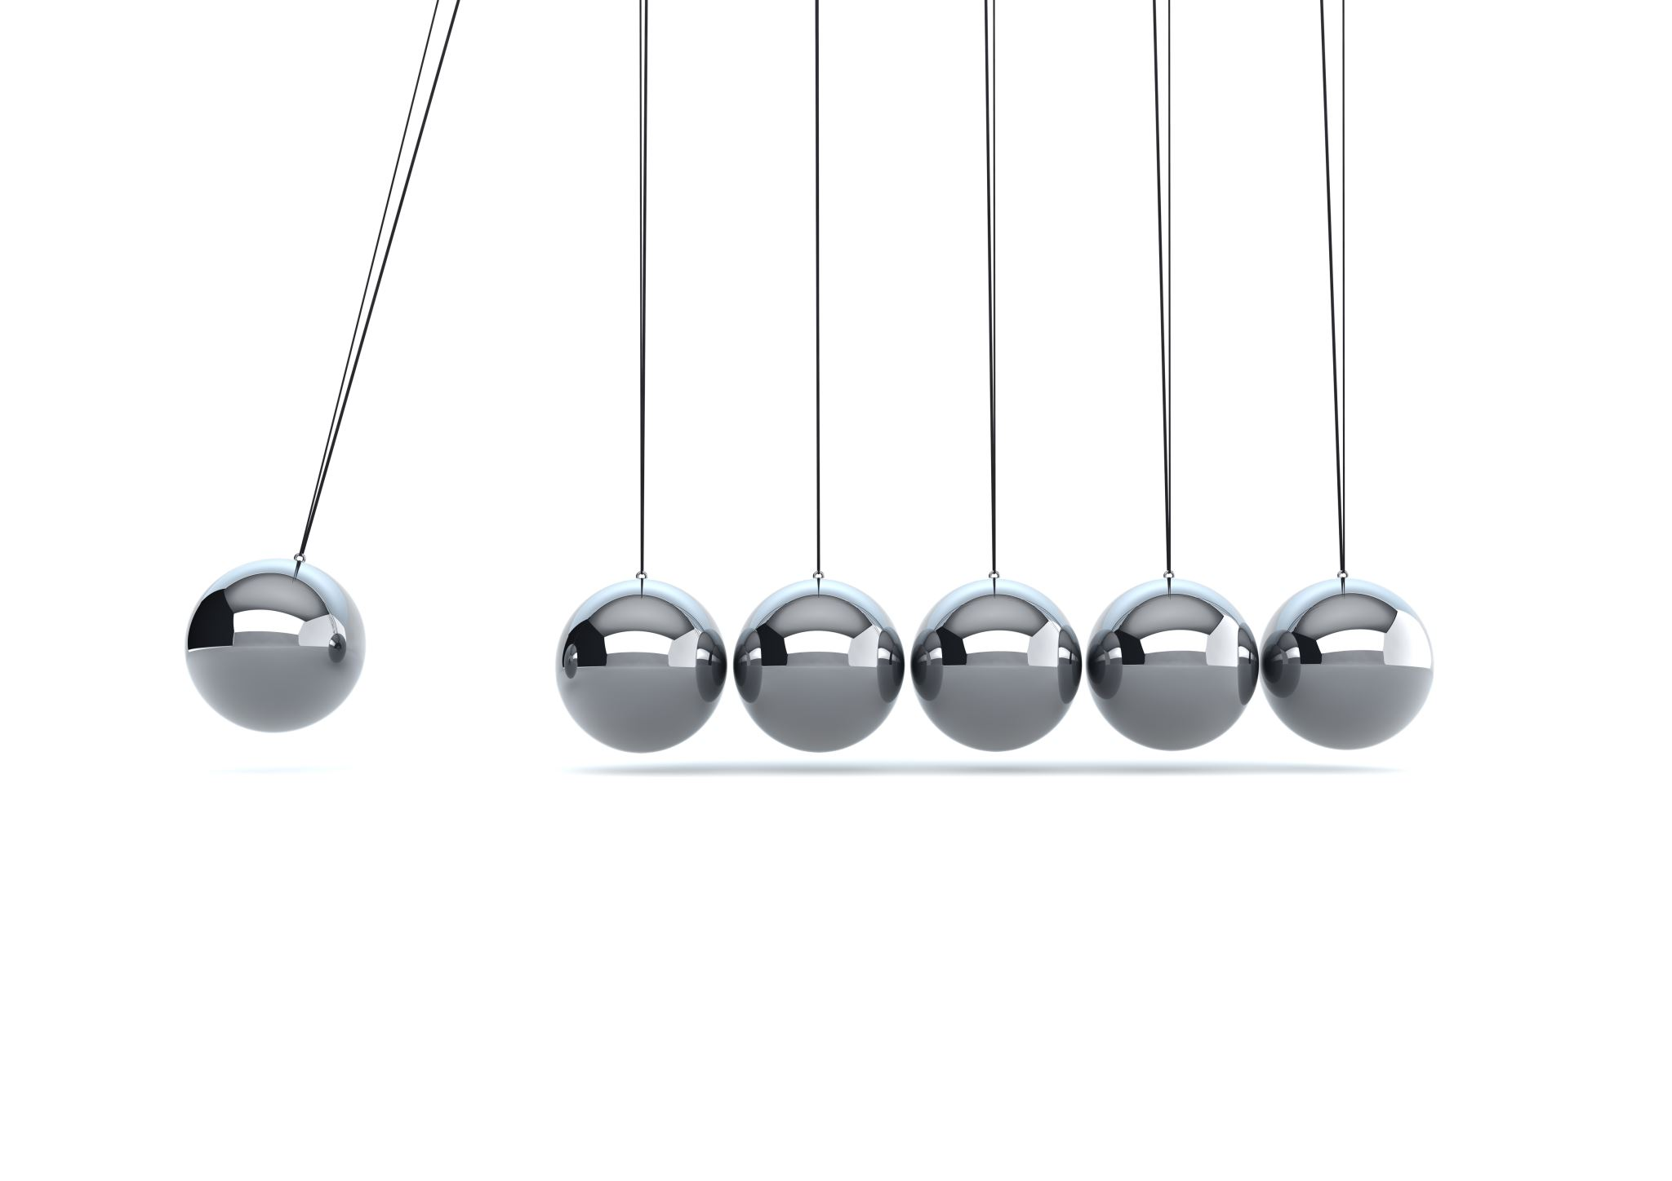
INDEX
Overview
Problem Statement
Problem Understanding
What is Car Price Prediction?
Importance of Car Prediction
Exploratory data analysis
Visualizations
Analysis
Data Cleaning Steps
Model Building
Hyper Parameter Tuning
Saving model & predictions for Best Model
Conclusion.

Slide 3

OVER VIEW FOR PREDICTION
In this Presentation we will be looking on the :-
How to analyze the dataset of Car Price Prediction.
What are EDA steps in cleaning the dataset.
Overall analysis on the problem.
Model building from the train dataset.
Predicting Loan Approval for customer.

Slide 4
PROBLEM STATEMENT
With the covid 19 impact in the market, we have seen lot of changes in the car market. Now some cars are in demand hence making them costly and some are not in demand hence cheaper. One of our clients works with small traders, who sell used cars. With the change in market due to covid 19 impact, our client is facing problems with their previous car price valuation machine learning models. So, they are looking for new machine learning models from new data. We have to make car price valuation model.
THIS PROJECT CONTAINS TWO PHASE
Scrapping data for 5000 cars
it include all types of cars in your data for example- SUV, Sedans, Coupe, minivan, Hatchback

Slide 5
UNDERSTANDING PROBLEM
ITEM 1
ITEM 2
MOTIVATION BEHIND
The most obvious effect of Covid-19 on the car market has been a quite dramatic fall in sales. “It’s 24 or 25 per cent down on 2019 which is the realistic base year to use.
That’s the equivalent of 16,000 cars not sold this year alone. Car use has changed during Covid. A lot of people haven’t used their cars at all except to drive to the shops for the past year. They’ve got used to that and don’t see a reason to change their car.”
It is a very large market and there are various companies working in the domain.
We are required to model the price of cars with the available independent variables. This model will then be used by the management to understand how exactly the prices that will help them to extract the car prices which are todays market.
Now some cars are in demand hence making them costly and some are not in demand hence cheaper.
One of our clients works with small traders, who sell used cars. With the change in market due to covid 19 impact, our client is facing problems with their previous car price valuation machine learning models. So, they are looking for new machine learning models from new data.

Slide 6
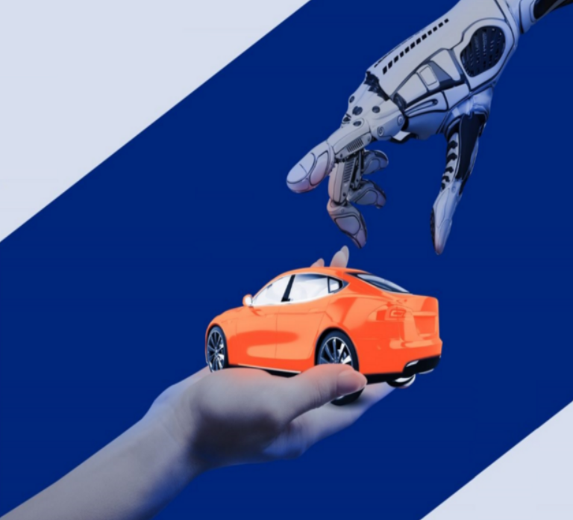

WHAT IS A CAR PREDICTION?:
The price of a car depends on a lot of factors like the goodwill of the brand of the car, features of the car, horsepower and the mileage it gives and many more. Car price prediction is one of the major research areas in Machine Learning.

Slide 7
What is the importance of car Prediction?
The main aim of this project is to predict the price of used cars using the various Machine Learning (ML) models. This can enable the customers to make decisions based on different inputs or factors namely
• Brand or Type of the car one prefers like Ford, Hyundai
• Model of the car namely Ford Figo, Hyundai Creta
• Location like Delhi, Chennai, Mumbai
• Year of manufacturing like 2020, 2021
• Type of fuel namely Petrol, Diesel
• Price range or Budget
• Type of transmission which the customer prefers like Automatic or Manual
• Mileage

Slide 8

EXPLORATORY DATA ANALYSIS :
As a first step I have imported required libraries, which were in csv format.
Then I did all the statistical analysis like checking shape, n unique(unique value each column contains, data types, value counts ,size )were checked.
While checking the info of the datasets I found some columns that two useless columns which contains numbers, Hence dropped those rows and all columns were explained.
Then while looking into the value counts I found some columns with more than 1980 duplicated rows, check was performed for first and last, later those columns were dropped.
Null values were checked and found null values and missing percentage visualization were performed on null values.

Slide 9
EXPLORATORY DATA ANALYSIS :
Feature Engineering were performed to give a meaning rows to kilometer and price columns.
Graph were plotted against the independent variables and univariate analysis were done on category and numerical columns and observation is noted.
Bi-variate analysis was done with price using Catplot and scatter plot and observations are noted.
Analysis were performed on the basis of state, brand, price, Make Year and Fuel type and total counts and graph were drawn.
Multi-variate graph were drawn to check the analysis.
Label Encoding is done, followed by Descriptive and Correlation graph were drawn.
Outliers and Skewness were checked using boxplot

Slide 10
EXPLORATORY DATA ANALYSIS :
Data Cleansing was performed, correlation were checked, Outliers were removed using zscore. (Note: Z>3 were removed)
Data loss was approx. 4 percent, We used new data frame for the further process.
Standard scaler was used to bring the data under a single scale.
Skewness were removed using power transform method.
Variance inflation factor were checked and Model building was performed.

Slide 11
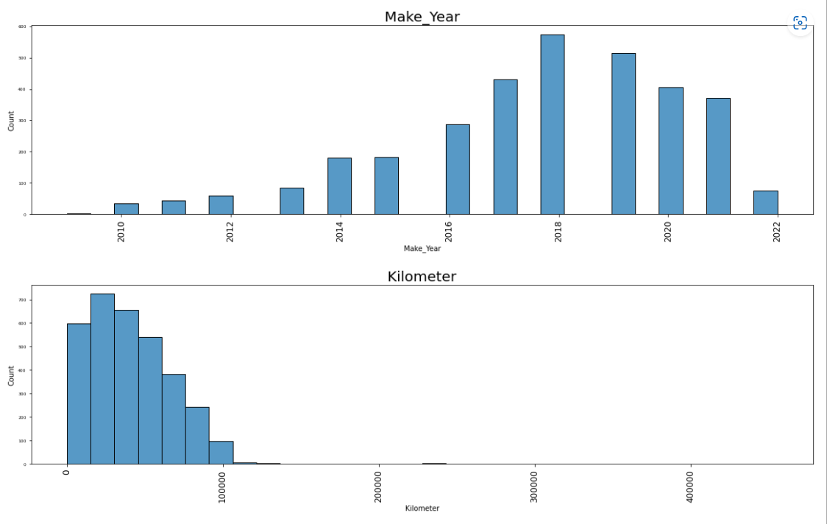
FEW VISUALIZATION ON NUMERICAL COLUMN

Slide 12
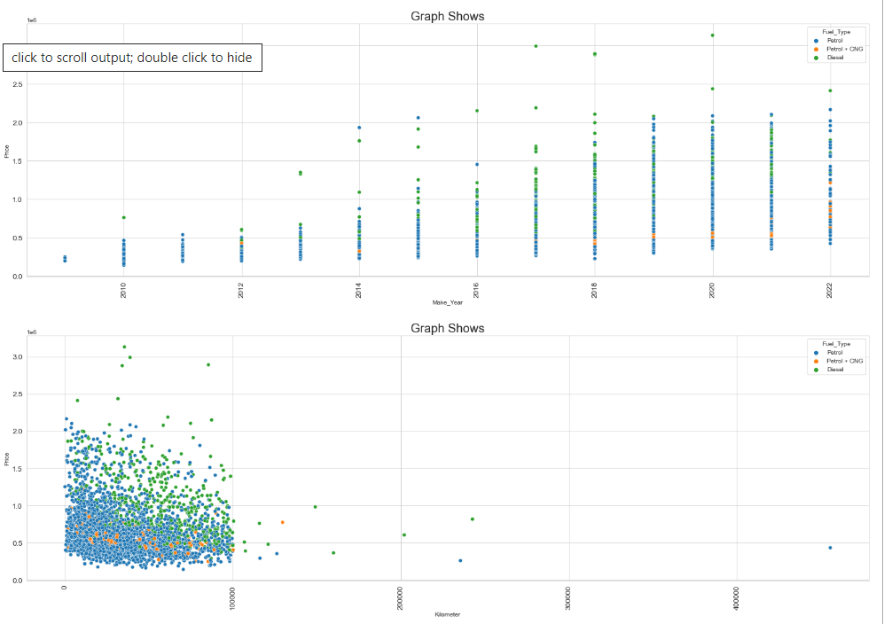
FEW VISUALIZATION ON NUMERICAL COLUMN

Slide 13
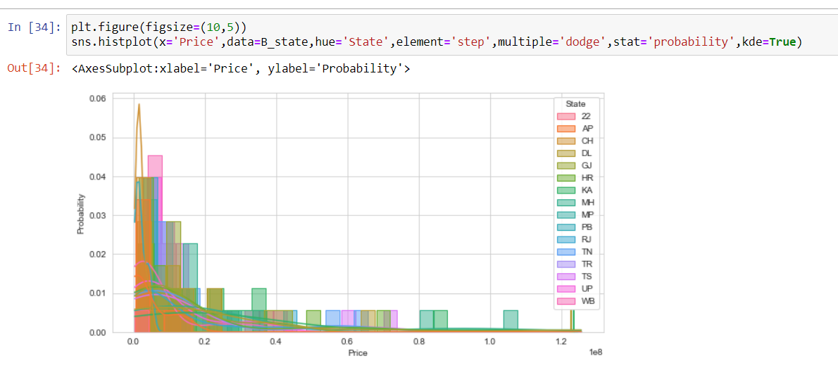
FEW VISUALIZATION ON NUMERICAL COLUMN

Slide 14
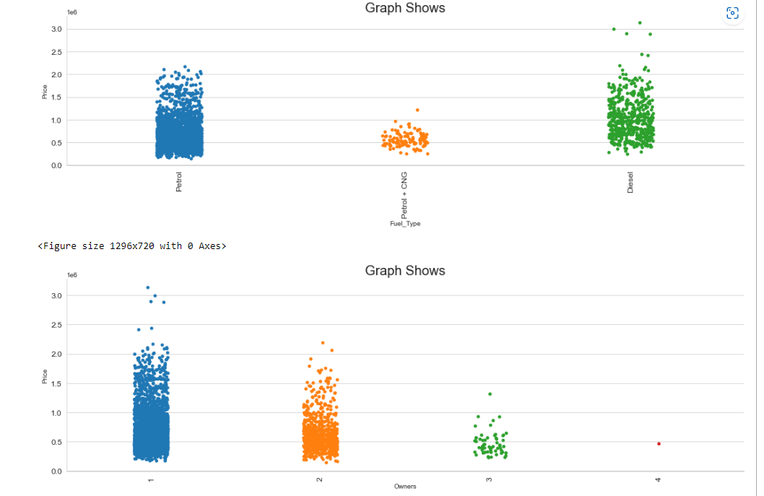
FEW VISUALIZATION ON CATEGORICAL COLUMN

Slide 15
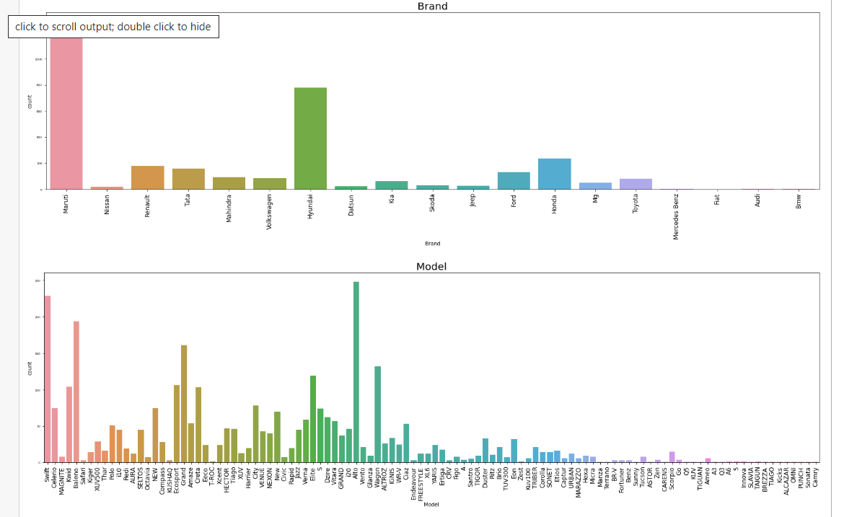
FEW VISUALIZATION ON CATEGORICAL COLUMN

Slide 16
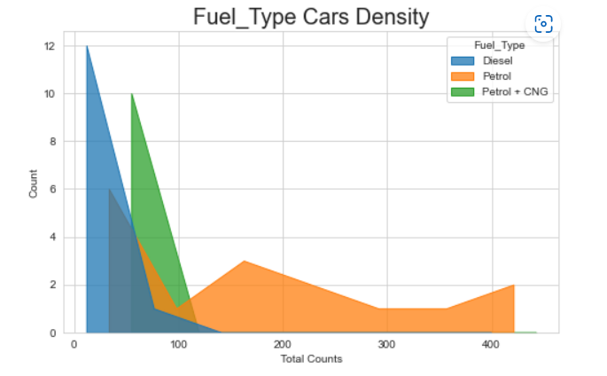
FEW VISUALIZATION ON CATEGORICAL COLUMN

Slide 17
Observation:
- Maruti Car (Brand) are for sale.
- Alto and Swift models cars are in maximum for sale.
- VXI and LXI variants are maximum for sale.
- Cars that are maximum for sale are in Make year between 2018 to 2019
- Maximum car are for sale lies between 40,000 to 50,000 km.
- Petrol cars are maximum for sale, Petrol + CNG cars are very less for sale.
- Maximum Sales are 1st Owners, followed by 2nd Owners.
- Delhi and Karnataka cars are maximum for sale.
- Maximum sellers lies between 3 lakhs to 5 lakhs

Slide 18
Observation:
- Diesel car prices are high as compare to petrol or model with petrol and CNG.
- 1st Owner sells their cars in high price.
- Datsun Price are low, Toyota ,Ford shows maximum prices for sale.
- Maruti and Tata and Hyundai prices are low deviation.
- Endeavour, Fortuner prices are high compare to others, Harrier, compass and XUV 500 shows high price cars
- Maximum sale of petrol cars in 2020 followed 2022.
- Price of Petrol Cars are high if the kilometers are less.
- Gujrat has maximum sellers of petrol cars.
- UP,KA,MH,HR,TN,DL,TS,AP,WB has maximum Diesel cars.

Slide 19
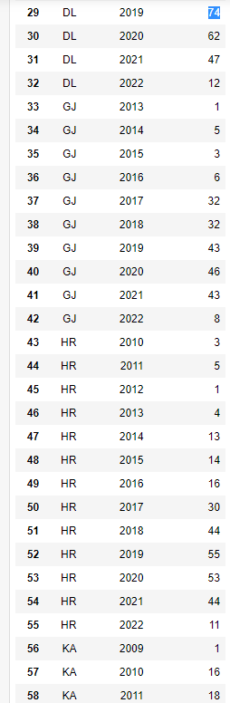
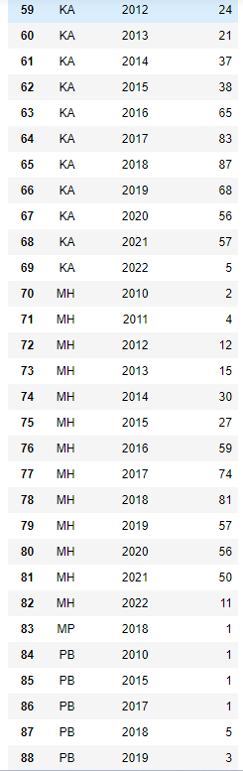
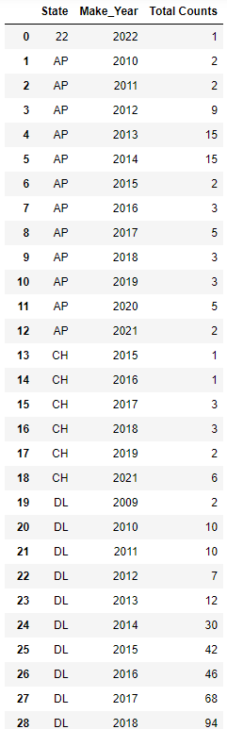
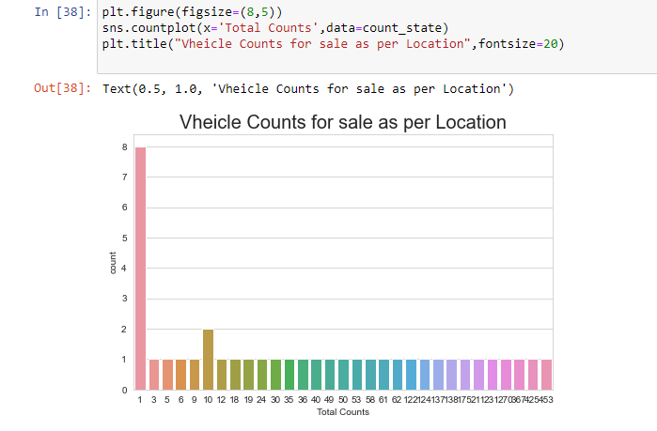
Observation of cars for SALE with Make year and Total Observations :

Slide 20

DATA ANALYSIS:
And also for continuous numerical variables I have used scatter plot to show the relationship between continuous numerical variable and target variable.
I have used cat plot to deter mine the relationship between category and selling Price
Other than cat plot, hist plot and count plot has been for target as well as independent variable.
I have used box plot for each pair of categorical features that shows the relation with the median sale price for all the sub categories in each categorical feature.
I found that there is a linear relationship between continuous numerical variable and SalePrice.

Slide 21

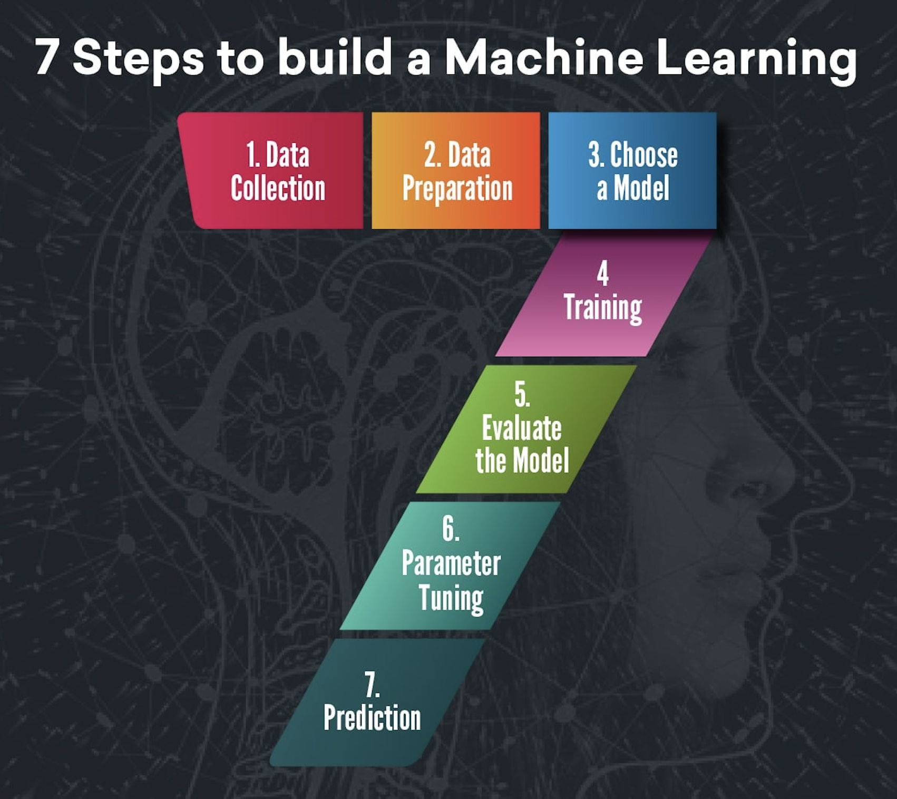
STEPS INVOLVED
Since SalePrice was my target and it was a continuous column so this particular problem was regression problem. And I have used all regression algorithms to build my model.
By looking into the difference of r2 score and cross validation score I found ExtraTreesRegressor as a best model with least difference and Random Forest Regressor was best too..
Also to get the best model I have to run through multiple models and to avoid the confusion of overfitting we have go through cross validation.

Slide 22

REGRESSION ALGORITHMS I HAVE USED IN MY PROJECT:
Linear Regression
Decision Tree Regressor.
KNeighbors Regressor
Support Vector Regressor
SGD Regressor
Extra Trees Regressor
Random Forest Regressor
Ada Boost Regressor
Gradient Boosting Regressor
MLP Regressor
Bagging Regressor

Slide 23
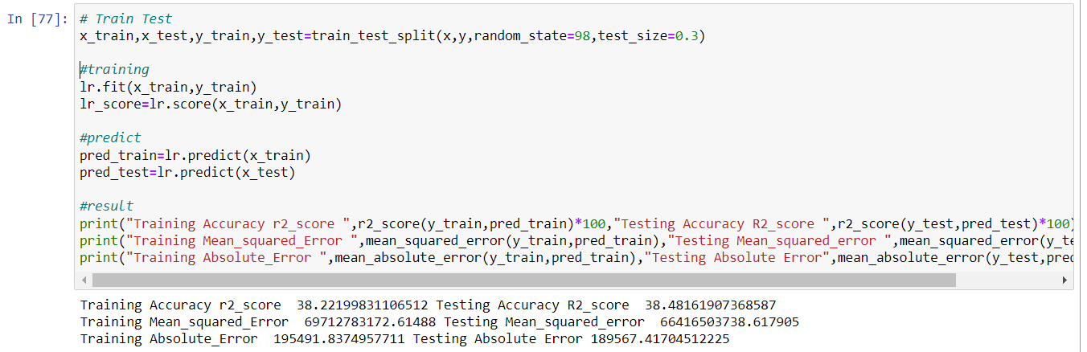
DIFFERENT MODELS WITH THEIR PERFORMANCE:
Linear Regression

Slide 24
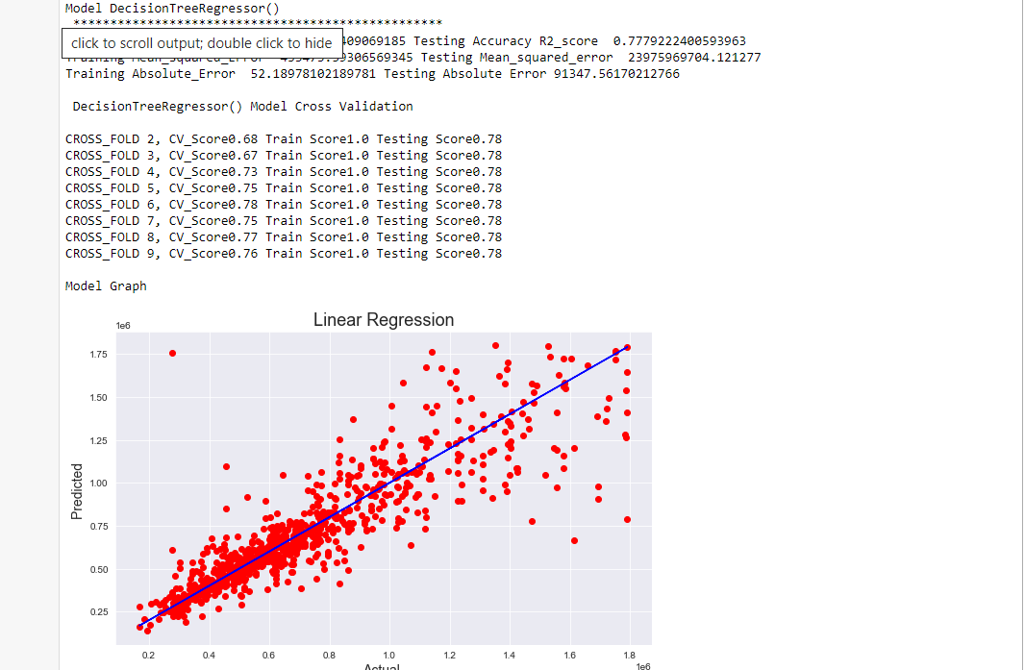
DIFFERENT MODELS WITH THEIR PERFORMANCE:
Decision Tree
Decision Tree

Slide 25
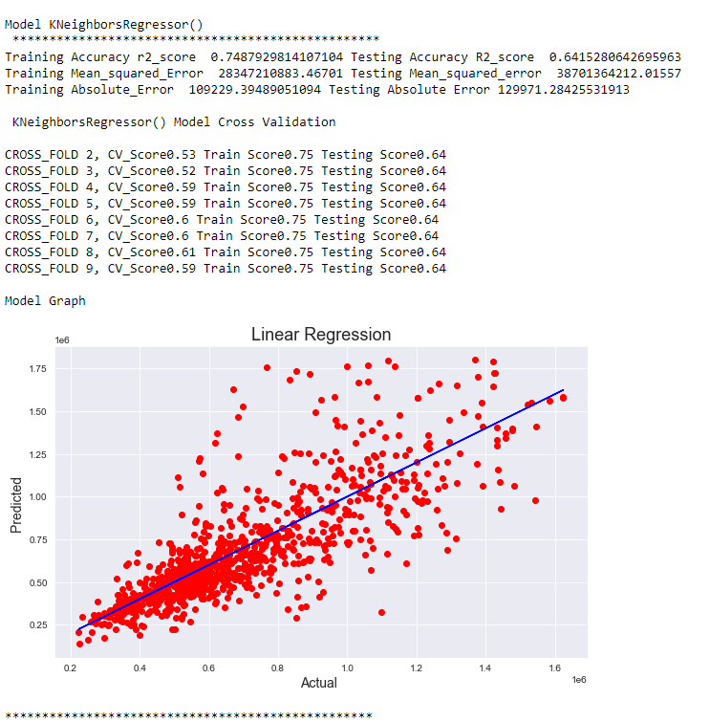
REGRESSION ALGORITHMS I HAVE USED IN MY PROJECT:
KNeighbors Regressor

Slide 26
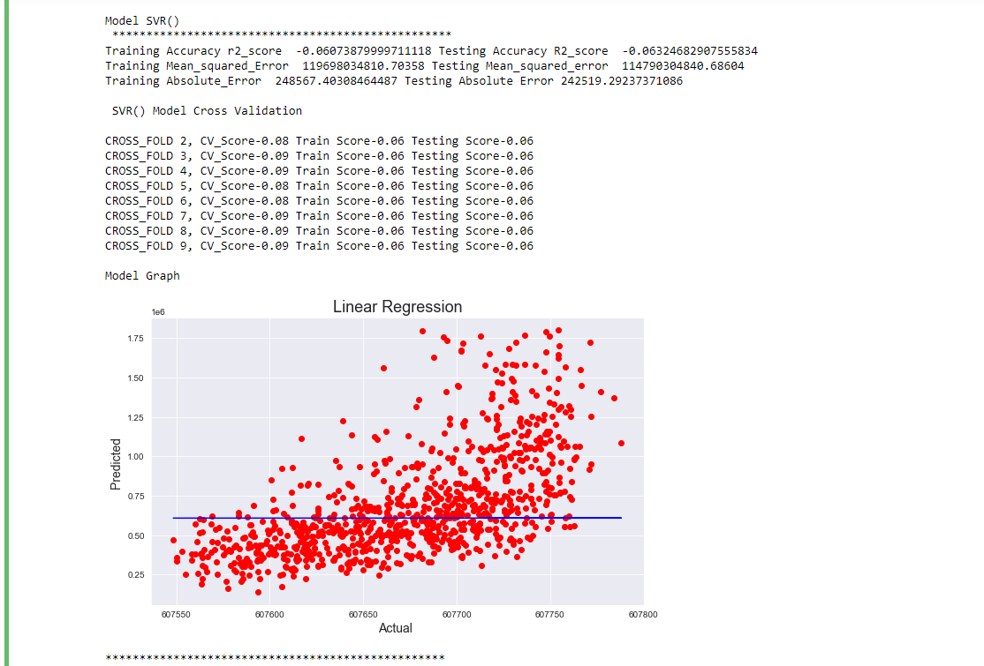
REGRESSION ALGORITHMS I HAVE USED IN MY PROJECT:
Support Vector Regressor

Slide 27
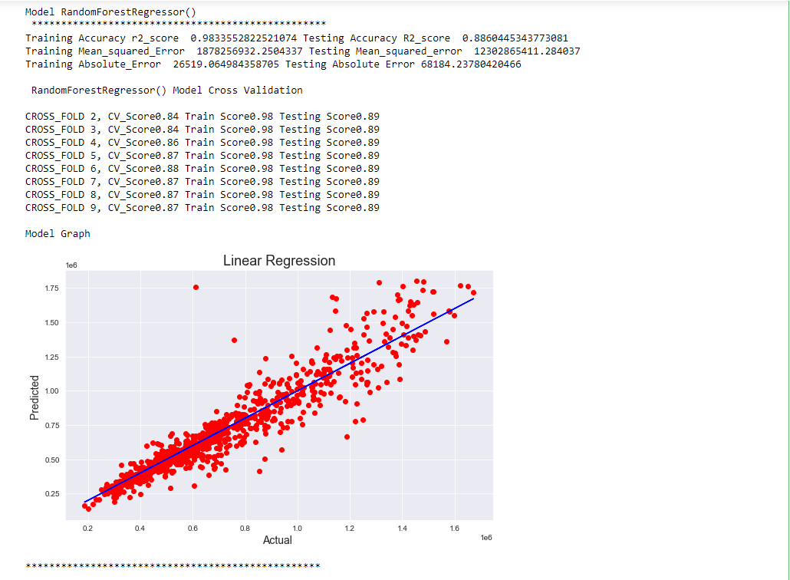
REGRESSION ALGORITHMS I HAVE USED IN MY PROJECT:
Random Forest Regressor

Slide 28
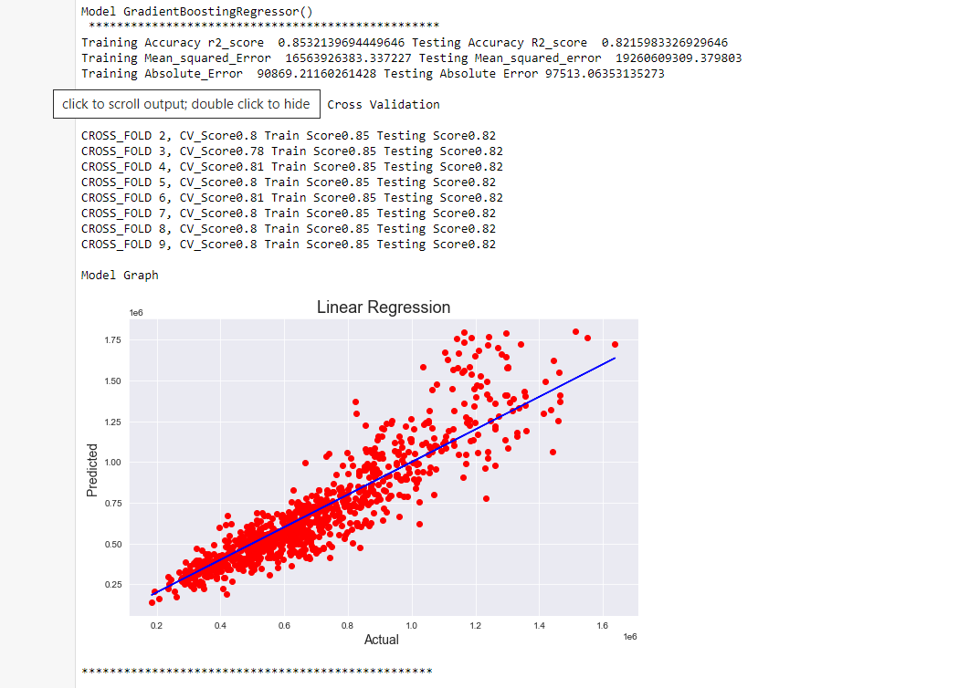
REGRESSION ALGORITHMS I HAVE USED IN MY PROJECT:
Gradient Boosting Regressor

Slide 29
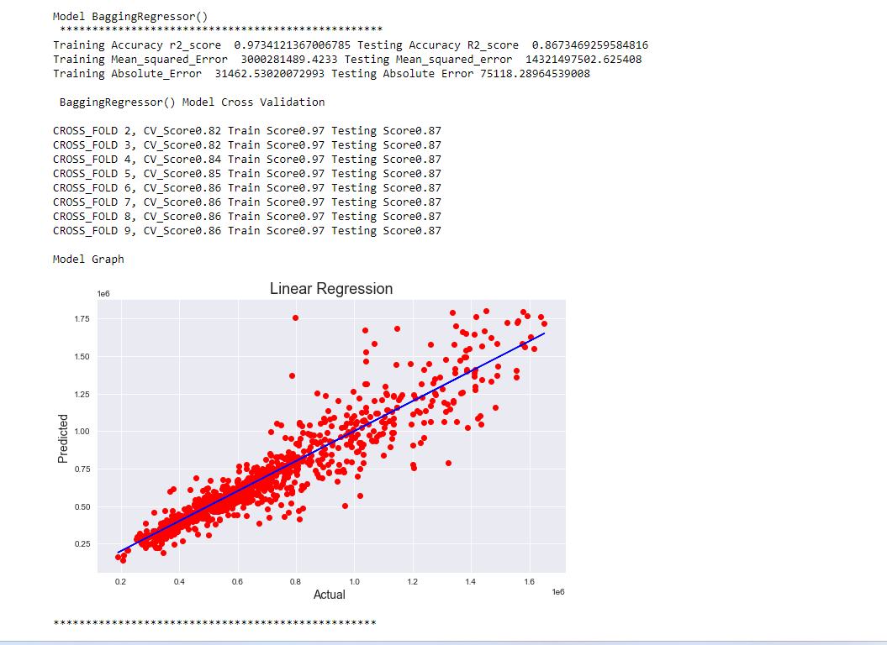
REGRESSION ALGORITHMS I HAVE USED IN MY PROJECT:
Bagging Regressor

Slide 30
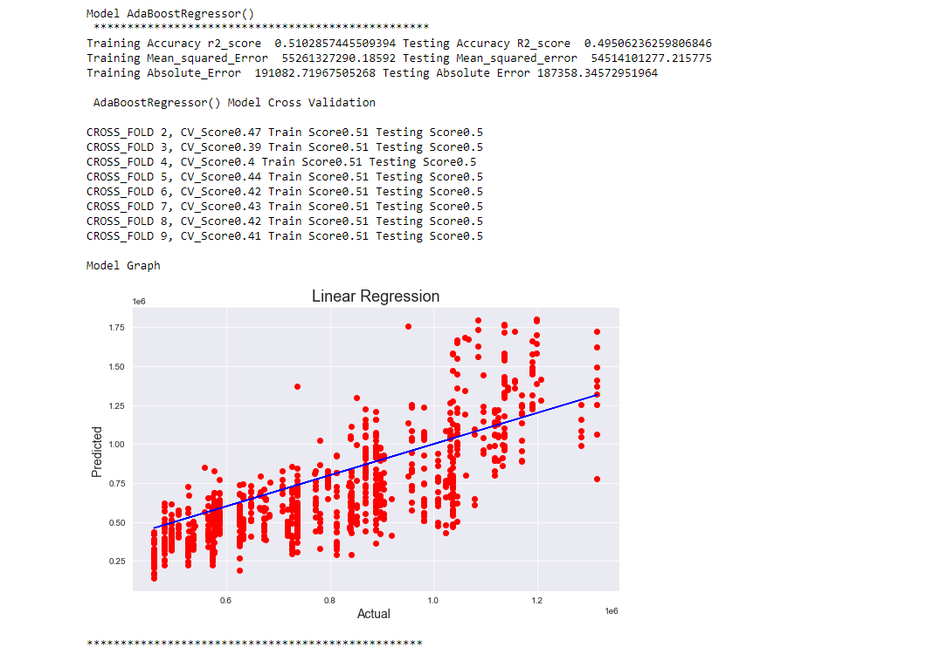
REGRESSION ALGORITHMS I HAVE USED IN MY PROJECT:
Ada Boost Regressor

Slide 31
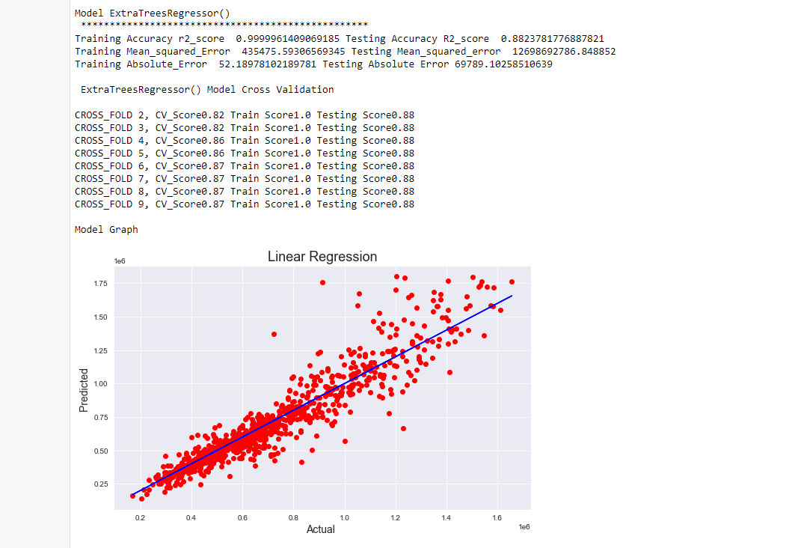
REGRESSION ALGORITHMS I HAVE USED IN MY PROJECT:
Extra Trees Regressor

Slide 32
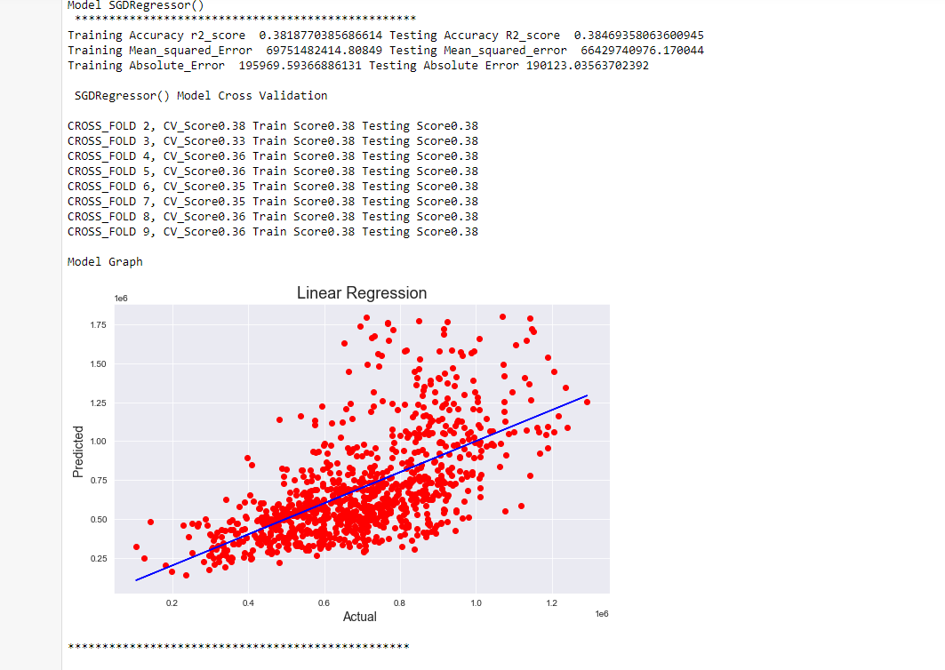
REGRESSION ALGORITHMS I HAVE USED IN MY PROJECT:
SGD Regressor

Slide 33
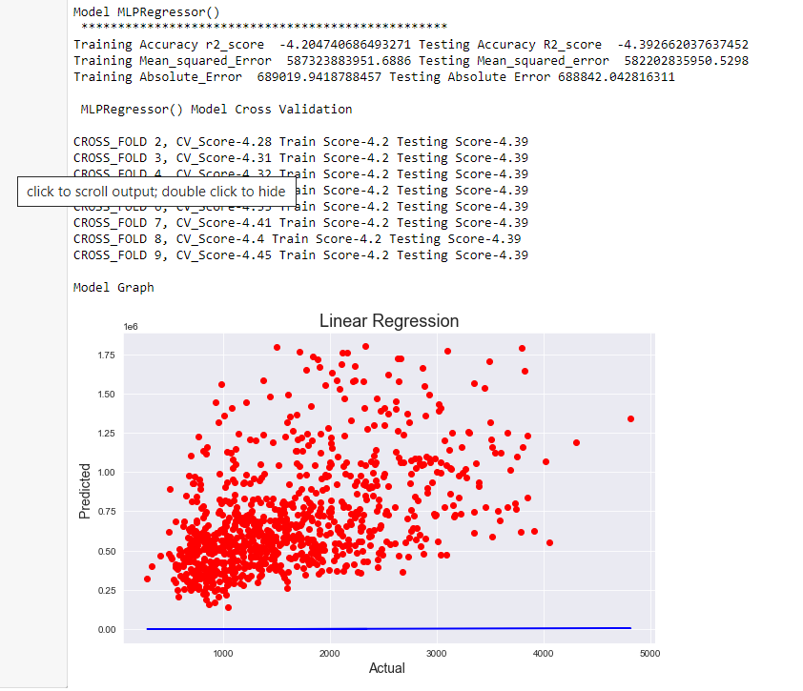
REGRESSION ALGORITHMS I HAVE USED IN MY PROJECT:
MLP Regressor

Slide 34
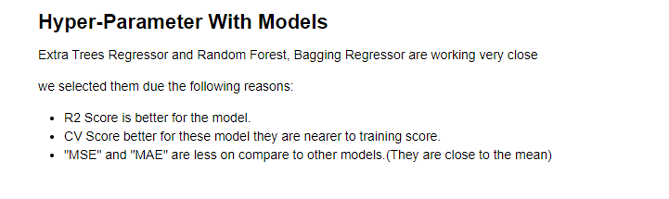
REGRESSION ALGORITHMS I HAVE USED IN MY PROJECT:
Extra Trees Regressor
Random Forest Regressor

Slide 35
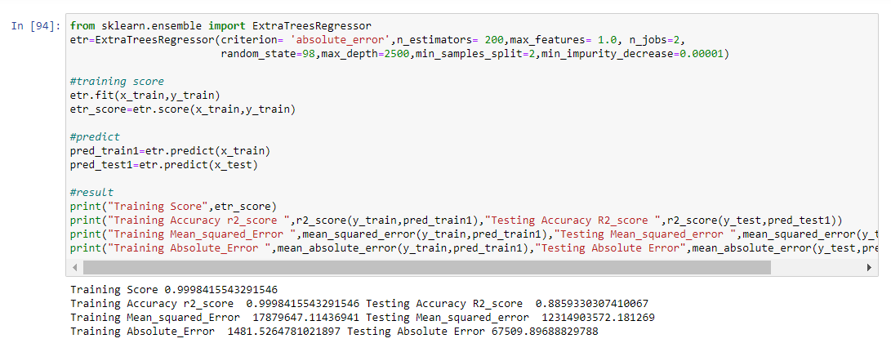
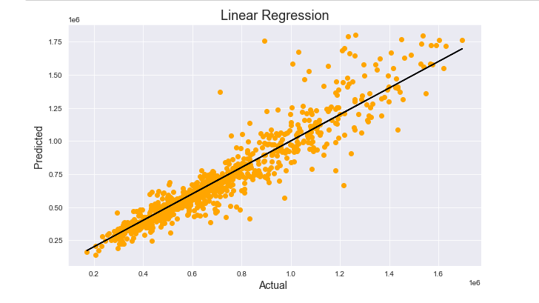
Using Hyperparameter:
Extra Trees Regressor

Slide 36
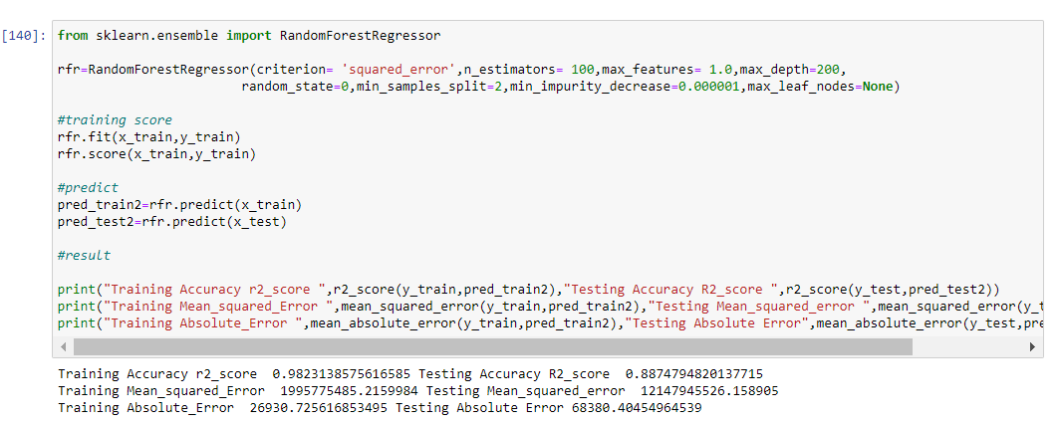
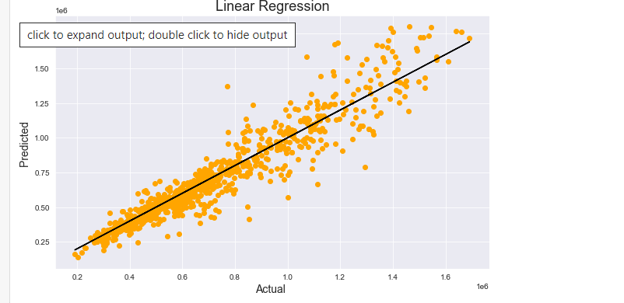
Using Hyperparameter
Random Forest Regressor

Slide 37
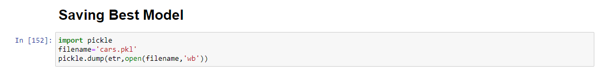
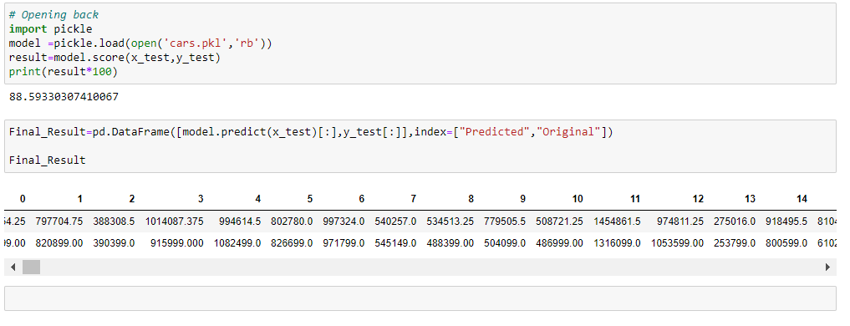
REGRESSION MODEL SAVING:
Model Loading Back:

Slide 38
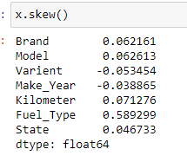
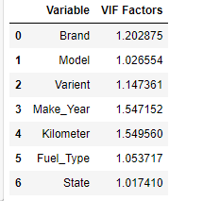
Conclusion:
In this project report, we have used machine learning algorithms to predict the Cars prices.
We have mentioned the step by step procedure to analyze the dataset and finding the correlation between the features. Thus we can select the features which are not correlated to each other and are independent in nature.
We calculated the performance of each model using different performance metrics and compared them based on these metrics.
There were large no. of feature present in our dataset, I analyzed the data and dropped all the necessary features.
From overall analysis and visualization I come into conclusion that , the feature that most effect the sales price of a cars are:

Slide 39

Final Conclusion
I hope this model will help companies to predict the actual value of the prospective properties and decide whether to invest in them or not.
To conclude, the application of machine learning in property research is still at an early stage. We hope this study has moved a small step ahead in providing some methodological and empirical contributions to cars appraisal, and presenting an alternative approach to the valuation of car prices.

Slide 40

Thankyou

